Slide 1
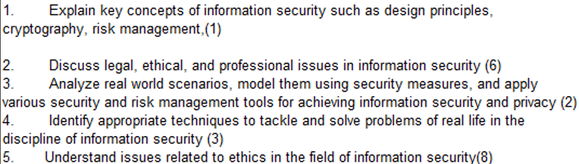
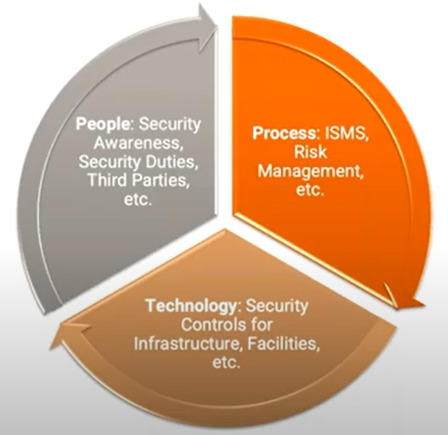
CS 3002 Information Security
Fall 2022
Week # 4 – Lecture # 9, 10, 11,12
16th , 17th , 18th Safar ul Muzaffar, 1444
13th , 14th, 15th September 2022
Dr. Nadeem Kafi Khan

Slide 2
Lecture # 9 - LAB
Encryption Lab
Frequency Analysis, All modes Encryption Modes (construction only), Authenticated Encryption. These are covered from the SEED slides for the Encryption Lab.
See Google Classroom post for further details.

Slide 3
Lecture # 10
Padding done before hashing. See Encryption Lab PKCS5 padding scheme.
Hash Function Requirements
Why we encryption hash values of a message?
Figure 2.5 (a) and (b) for symmetric and Asymmetric encryptions
Application of Hash functions: Passwords and Intrusion detection
Public Key Encryption
Generation of key pair (K1, K2) and use them as private and public keys
Figure 2.6 (a) Encryption with Public key and (b) Encryption with private key
Application of Public Key Cryptosystems: Table 2.3

Slide 4
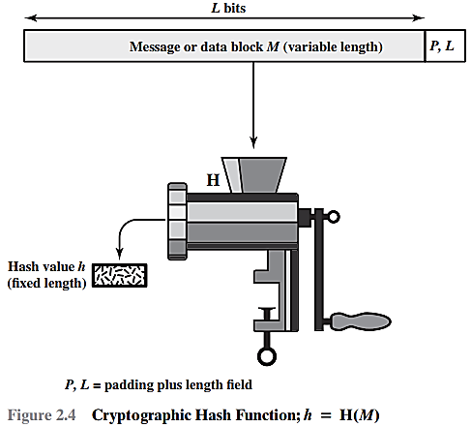

To accommodate variable size messages or data blocks

Slide 5

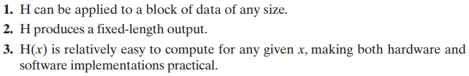
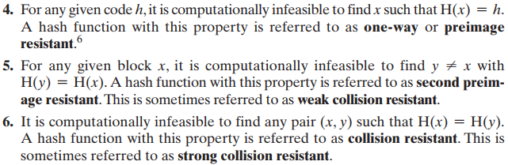

Slide 6
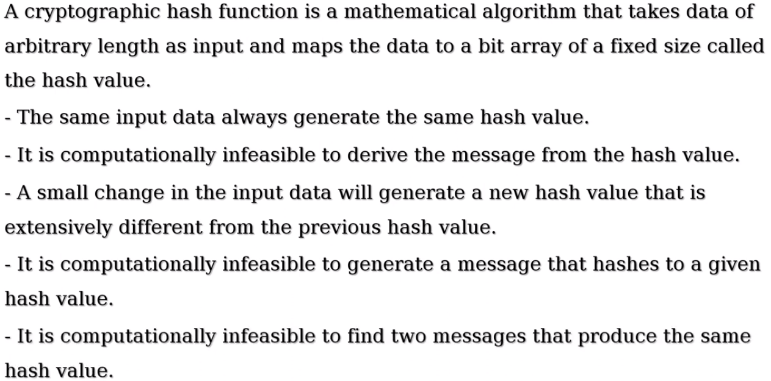

Slide 7
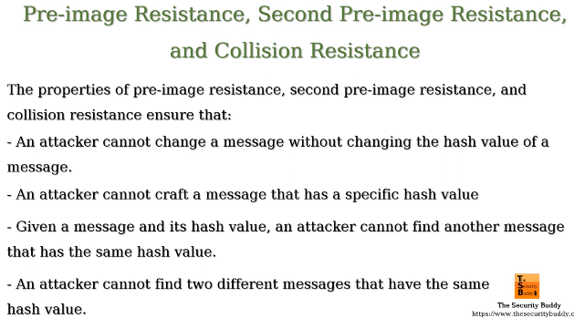
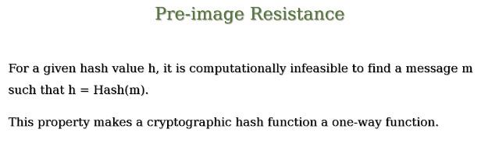
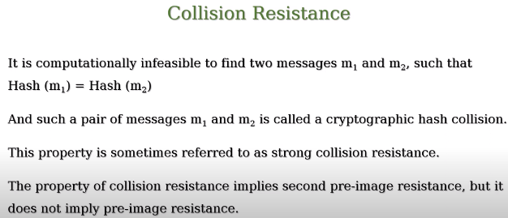
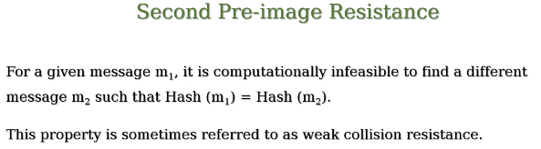

Slide 8
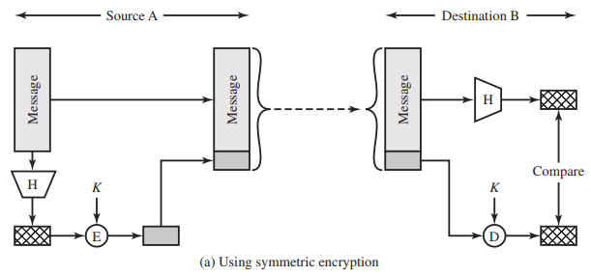
if it is assumed that only the sender and receiver share the encryption key, then authenticity is assured
Why Encryption?

Slide 9
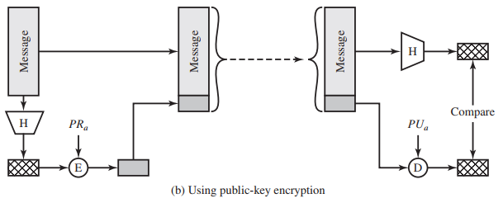
The public key approach has two advantages: It provides a digital signature as well as message authentication, and it does not require the distribution of keys to communicating parties.

Slide 10
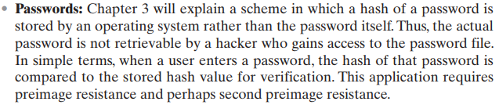
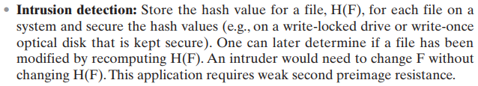

Slide 11
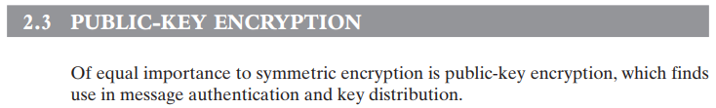
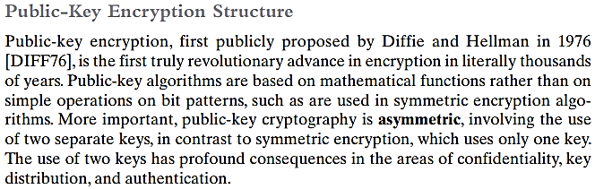

Slide 12
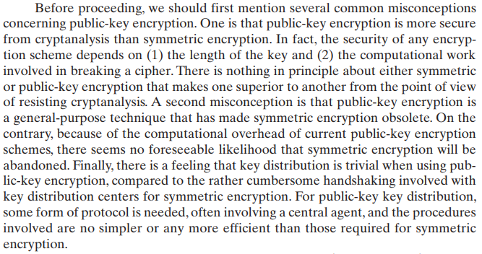

Slide 13
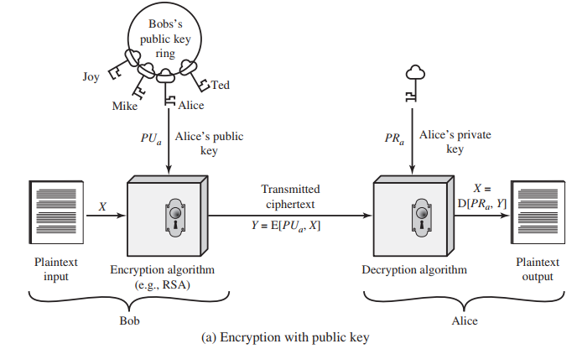

Slide 14
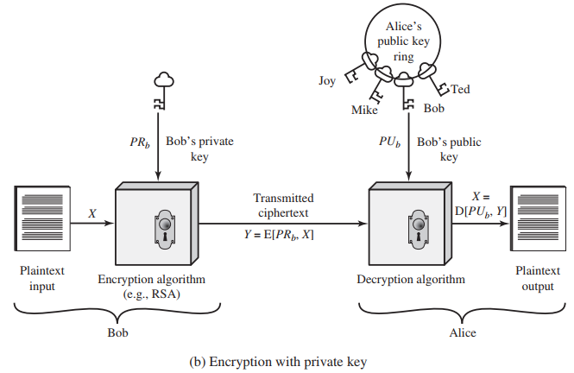

Slide 15
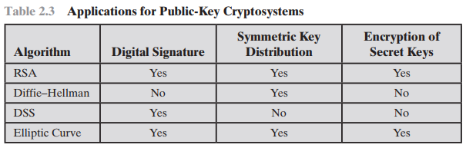

Slide 16
Lecture # 11
Requirement of Public Key cryptography (self reading)
RSA (basic Introduction) – Asymmetric Encryption Algorithm
Three different aspect of using Public Key Cryptosystems
Digital Signatures
Not part of syllabus: Public Certificates to secure public keys

Slide 17
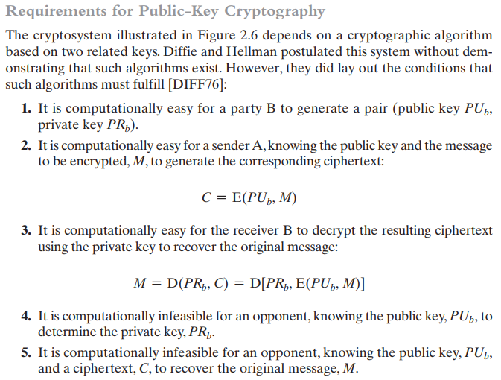
Self Reading

Slide 18
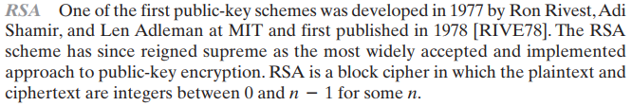

FACT 1, FACT 2 and Conjecture # 3 are not part of syllabus

Slide 19
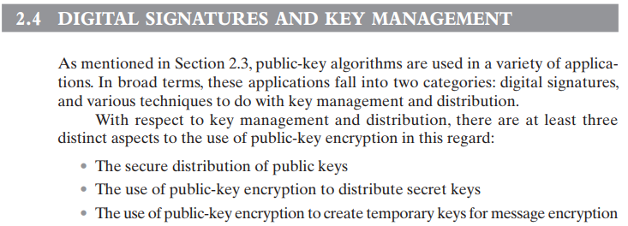

Slide 20
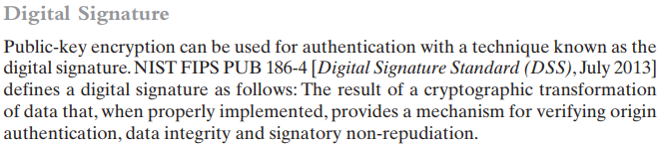
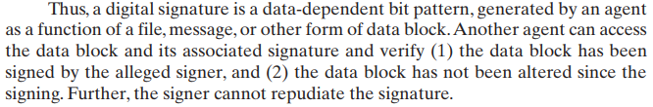

Slide 21
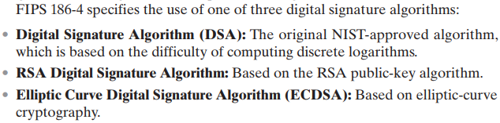

Slide 22
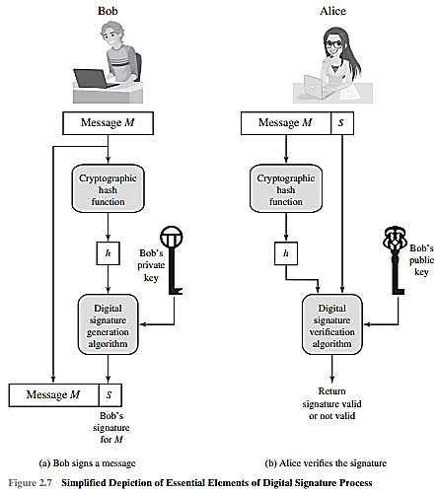

Slide 23
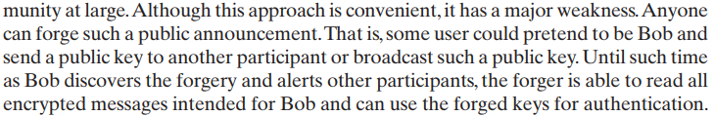
of the public key.

Slide 24
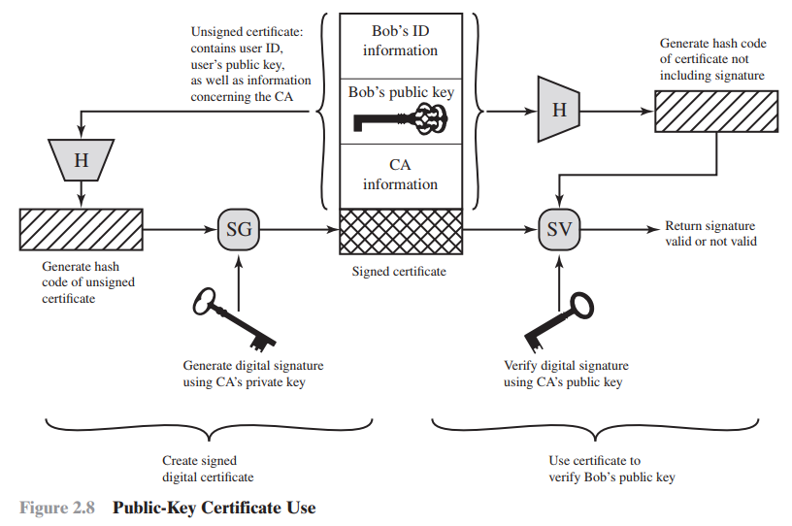

Slide 25
Lecture # 12
Review of Chapter # 2 key terms
User authentication (Chapter # 3)
Introduction
Identification and Authentication Security Requirements
NIST E-Authentication Architectural Model

Slide 26
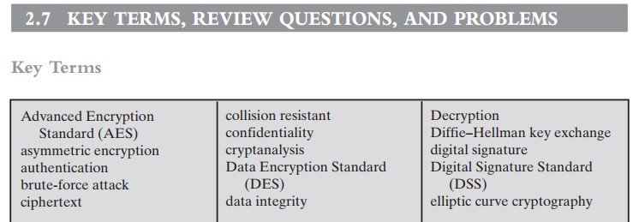
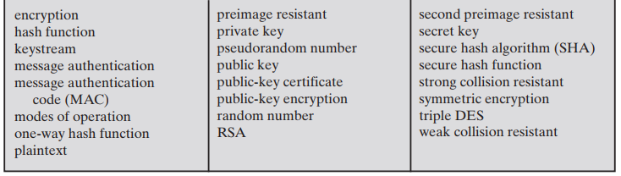

Slide 27
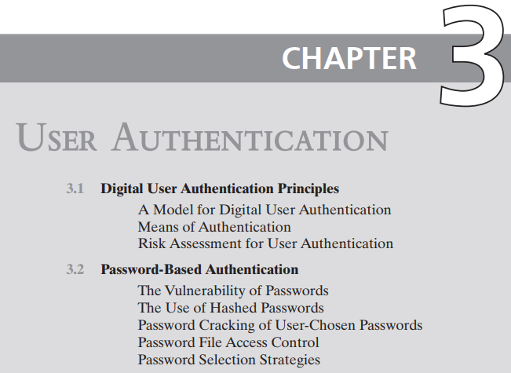

Slide 28
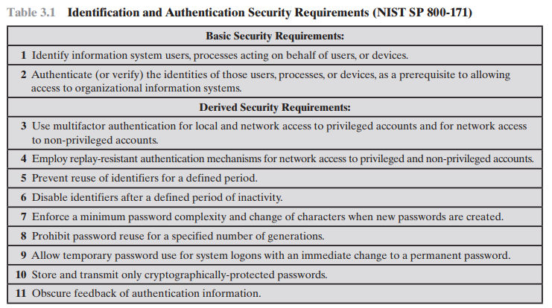

Slide 29
